Slide 1
Dynamic Computation
Dr. Yan Yan

Slide 2
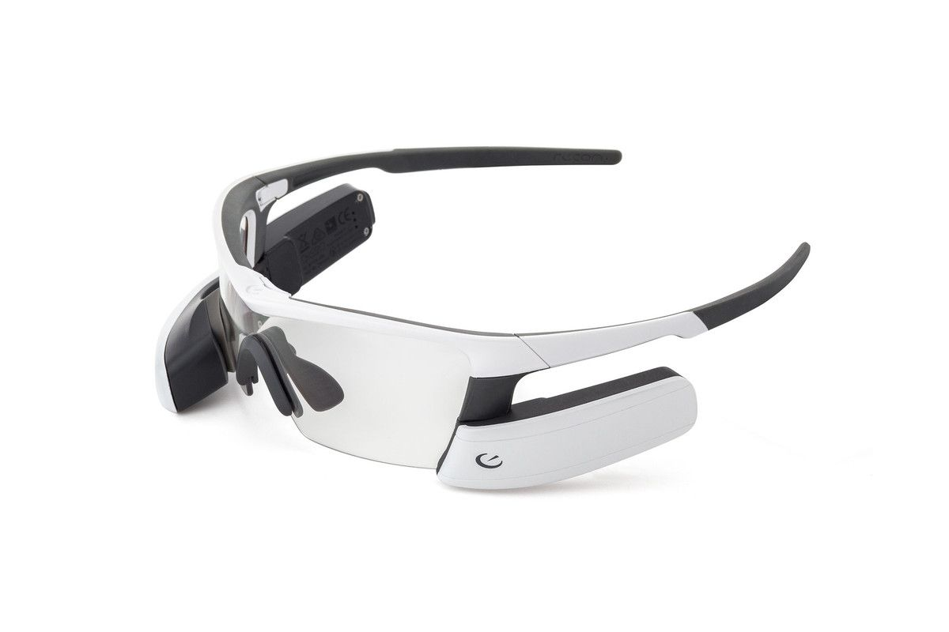



Dynamic Computation
The network adjusts the computation it need.
Why don’t we prepare a set of models?
Different devices
high/low battery

Slide 3









Dynamic Depth
$$L=e_{1}+e_{2}+…+e_{L}$$
high battery
Layer
1
Layer
2
Layer
L
…
$$y$$
$$\hat{y}$$
$$e_{L}$$
Extra Layer 1
Extra Layer 2
Does it work well?
Multi-Scale Dense Network (MSDNet)
$$y′$$
$$y′′$$
low battery
$$e_{1}$$
$$e_{2}$$
https://arxiv.org/abs/1703.09844
$$\hat{y}$$
$$\hat{y}$$

Slide 4
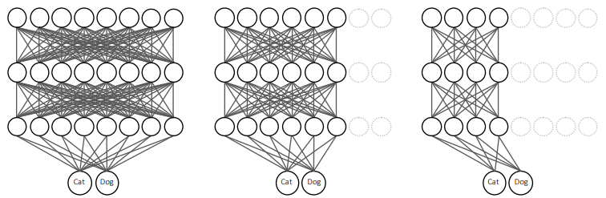


Dynamic Width
$$L=e_{1}+e_{2}+e_{3}$$
$$e_{1}$$
$$e_{2}$$
$$e_{3}$$
$$\hat{y}$$
$$\hat{y}$$
$$\hat{y}$$
Slimmable Neural Networks https://arxiv.org/abs/1812.08928

Slide 5


Computation based on Sample Difficulty
Layer
1
Layer
2
Layer
L
…
$$y$$
Simple
Stop!
$$y′$$
$$y′′$$
cat
Layer
1
Layer
2
Layer
L
…
$$y$$
cat
Difficult
Don’t Stop!
Mexican rolls
Mexican rolls
$$y′$$
$$y′′$$
Don’t Stop!
SkipNet: Learning Dynamic Routing in Convolutional Networks
Runtime Neural Pruning
BlockDrop: Dynamic Inference Paths in Residual Networks

Slide 6
Concluding Remarks
Network Pruning
Knowledge Distillation
Parameter Quantization
Architecture Design
Dynamic Computation

Slide 7
Reference
Binary Connect: https://arxiv.org/abs/1511.00363
Binary Network:https://arxiv.org/abs/1602.02830
XNOR-net: https://arxiv.org/abs/1603.05279
Knowledge Distillation https://arxiv.org/pdf/1503.02531.pdf
Do Deep Nets Really Need to be Deep? https://arxiv.org/pdf/1312.6184.pdf
SqueezeNet: https://arxiv.org/abs/1602.07360
MobileNet: https://arxiv.org/abs/1704.04861
ShuffleNet: https://arxiv.org/abs/1707.01083
Xception: https://arxiv.org/abs/1610.02357
GhostNet: https://arxiv.org/abs/1911.11907

